Slide 1
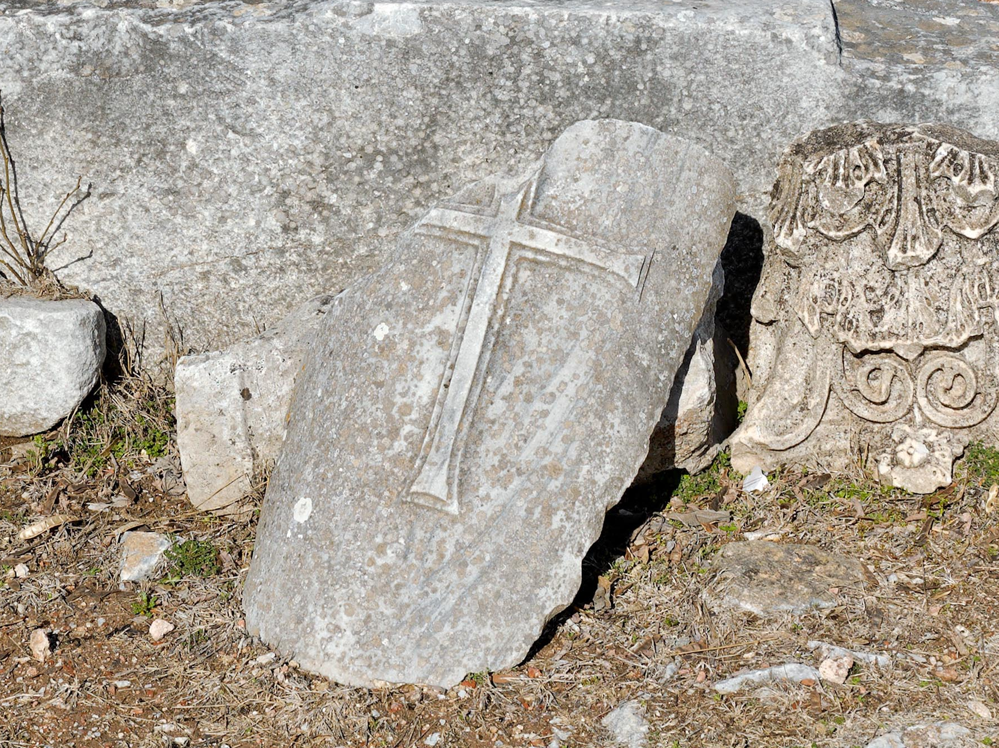
Philippians 1.9-11
Ruins in ancient Philippi / photo ©2012 Todd Bolen/ BiblePlaces.com

Slide 2
Philippians 1.9-11 NET: And I pray this, that your love may abound even more and more in knowledge and every kind of insight so that you can decide what is best, and thus be sincere and blameless for the day of Christ, filled with the fruit of righteousness that comes through Jesus Christ to the glory and praise of God.

Slide 3
1.1-2: Authors = slaves; readers = saints in Christ
1.3-8: Thankful for partnership in gospel mission
1.9-11: Prayer for discernment of what is right, so they remain righteous and partnered with him.

Slide 4
Philippians 1.9-11 NET: And I pray this, that your love may abound even more and more in knowledge and every kind of insight so that you can decide what is best, and thus be sincere and blameless for the day of Christ, filled with the fruit of righteousness that comes through Jesus Christ to the glory and praise of God.

Slide 5
Fruit of righteousness to counter sin…
Inherited Sin = Corruption to our human nature

Slide 6
Fruit of righteousness to counter sin…
Inherited Sin = corruption to our human nature
Acts of Sin = behavior against God’s will or character

Slide 7
Fruit of righteousness to counter sin…
Inherited Sin = corruption to our human nature
Acts of Sin = behavior against God’s will or character
Imputed Sin = guilt accounted to all in human race

Slide 8
Fruit of righteousness to counter sin…
Imputed Righteousness = the righteousness of Christ accounted to believers in Christ

Slide 9
Fruit of righteousness to counter sin…
Imputed Righteousness = the righteousness of Christ accounted to believers in Christ
Progressive Sanctification = the process of purifying a believer’s character or nature

Slide 10
Fruit of righteousness to counter sin…
Imputed Righteousness = the righteousness of Christ accounted to believers in Christ
Progressive Sanctification = the process of purifying a believer’s character or nature
Experiential Righteousness = the believer’s experience of righteousness in character and lifestyle

Slide 11
Philippians 1.9-11 NET: And I pray this, that your love may abound even more and more in knowledge and every kind of insight so that you can decide what is best, and thus be sincere and blameless for the day of Christ, filled with the fruit of righteousness that comes through Jesus Christ to the glory and praise of God.

Slide 12
Philippians 1.9-11 NET: And I pray this, that your love may abound even more and more in knowledge and every kind of insight so that you can decide what is best, and thus be sincere and blameless for the day of Christ, filled with the fruit of righteousness that comes through Jesus Christ to the glory and praise of God.
Fruit that is imputed righteousness [salvation]
Fruit that is experiential righteousness
[= fruit from imputed righteousness]

Slide 13
Philippians 1.9-11 NET: And I pray this, that your love may abound even more and more in knowledge and every kind of insight so that you can decide what is best, and thus be sincere and blameless for the day of Christ, filled with the fruit of righteousness that comes through Jesus Christ to the glory and praise of God.
Imputed Righteousness
Knowledge
& Insight
Love Abounding
Experiential Righteousness
Sincere & Blameless
Decide
What Is Best
Glory and Praise to God

Slide 14
Philippians 1.9-11 NET: And I pray this, that your love may abound even more and more in knowledge and every kind of insight...
ἐπίγνωσις = knowledge of God through Christ
Imputed Righteousness
Knowledge
& Insight
Love Abounding
Experiential Righteousness
Sincere & Blameless
Decide
What Is Best
Glory and Praise to God

Slide 15
Philippians 1.9-11 NET: And I pray this, that your love may abound even more and more in knowledge and every kind of insight...
αἴσθησις = capacity to understand morally
Imputed Righteousness
Knowledge
& Insight
Love Abounding
Experiential Righteousness
Sincere & Blameless
Decide
What Is Best
Glory and Praise to God

Slide 16
Philippians 1.9-11 NET: And I pray this, that your love may abound even more and more in knowledge and every kind of insight...
περισσεύω = abound, be abundant, overflow
Imputed Righteousness
Knowledge
& Insight
Love Abounding
Experiential Righteousness
Sincere & Blameless
Decide
What Is Best
Glory and Praise to God

Slide 17
Philippians 1.9-11 : And I pray this, that your love may abound even more and more in knowledge and every kind of insight so that you can decide what is best...
“so that you approve that which is superior”
δοκιμάζω = approval following an examination
Imputed Righteousness
Knowledge
& Insight
Love Abounding
Experiential Righteousness
Sincere & Blameless
Decide
What Is Best
Glory and Praise to God

Slide 18
Philippians 1.9-11 NET: And I pray this, that your love may abound even more and more in knowledge and every kind of insight so that you can decide what is best, and thus be sincere and blameless for the day of Christ, filled with the fruit of righteousness that comes through Jesus Christ to the glory and praise of God.
Imputed Righteousness
Knowledge
& Insight
Love Abounding
Experiential Righteousness
Sincere & Blameless
Decide
What Is Best
Glory and Praise to God

Slide 19
Philippians 1.9-11 NET: And I pray this, that your love may abound even more and more in knowledge and every kind of insight so that you can decide what is best, and thus be sincere and blameless for the day of Christ, filled with the fruit of righteousness that comes through Jesus Christ to the glory and praise of God.

